Slide 1
Tservice
By: Siddhartha Karnam
Sumanth Reddy CH
Web Programming - Final Project

Slide 2
User
Problem: A combination website to book a Flight tickets, Parking and Car rentals.
Input: Login or Register, and then start booking Flight tickets and booking for car rentals , parking from destination place.
Output: After payment, you will confirmation mail (extra feature).

Slide 3
Design
Please rewind back to our demo of our website.

Slide 4
Code/Languages
PHP
HTML
CSS
SQL
JavaScript
Ajax
Jquery
Bootstrap
Codeigniter Framework

Slide 5
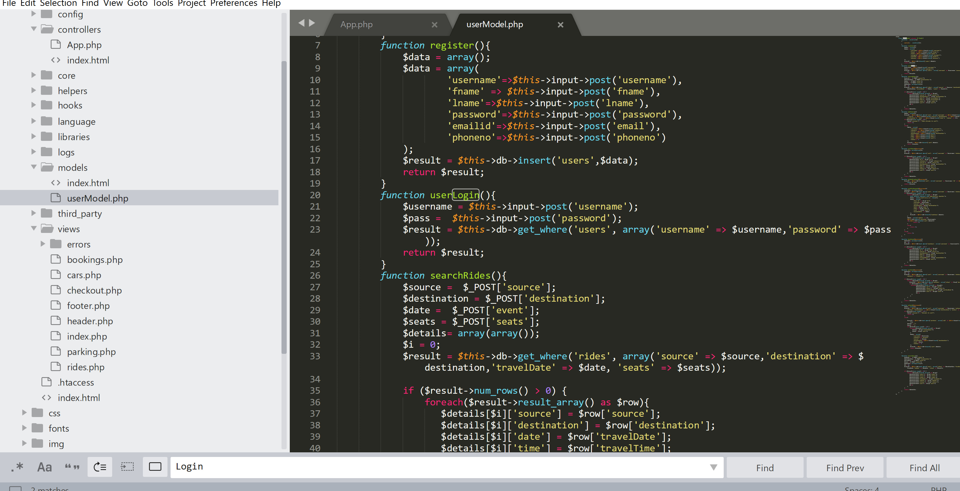
Code Snippets - Model (MVC)

Slide 6
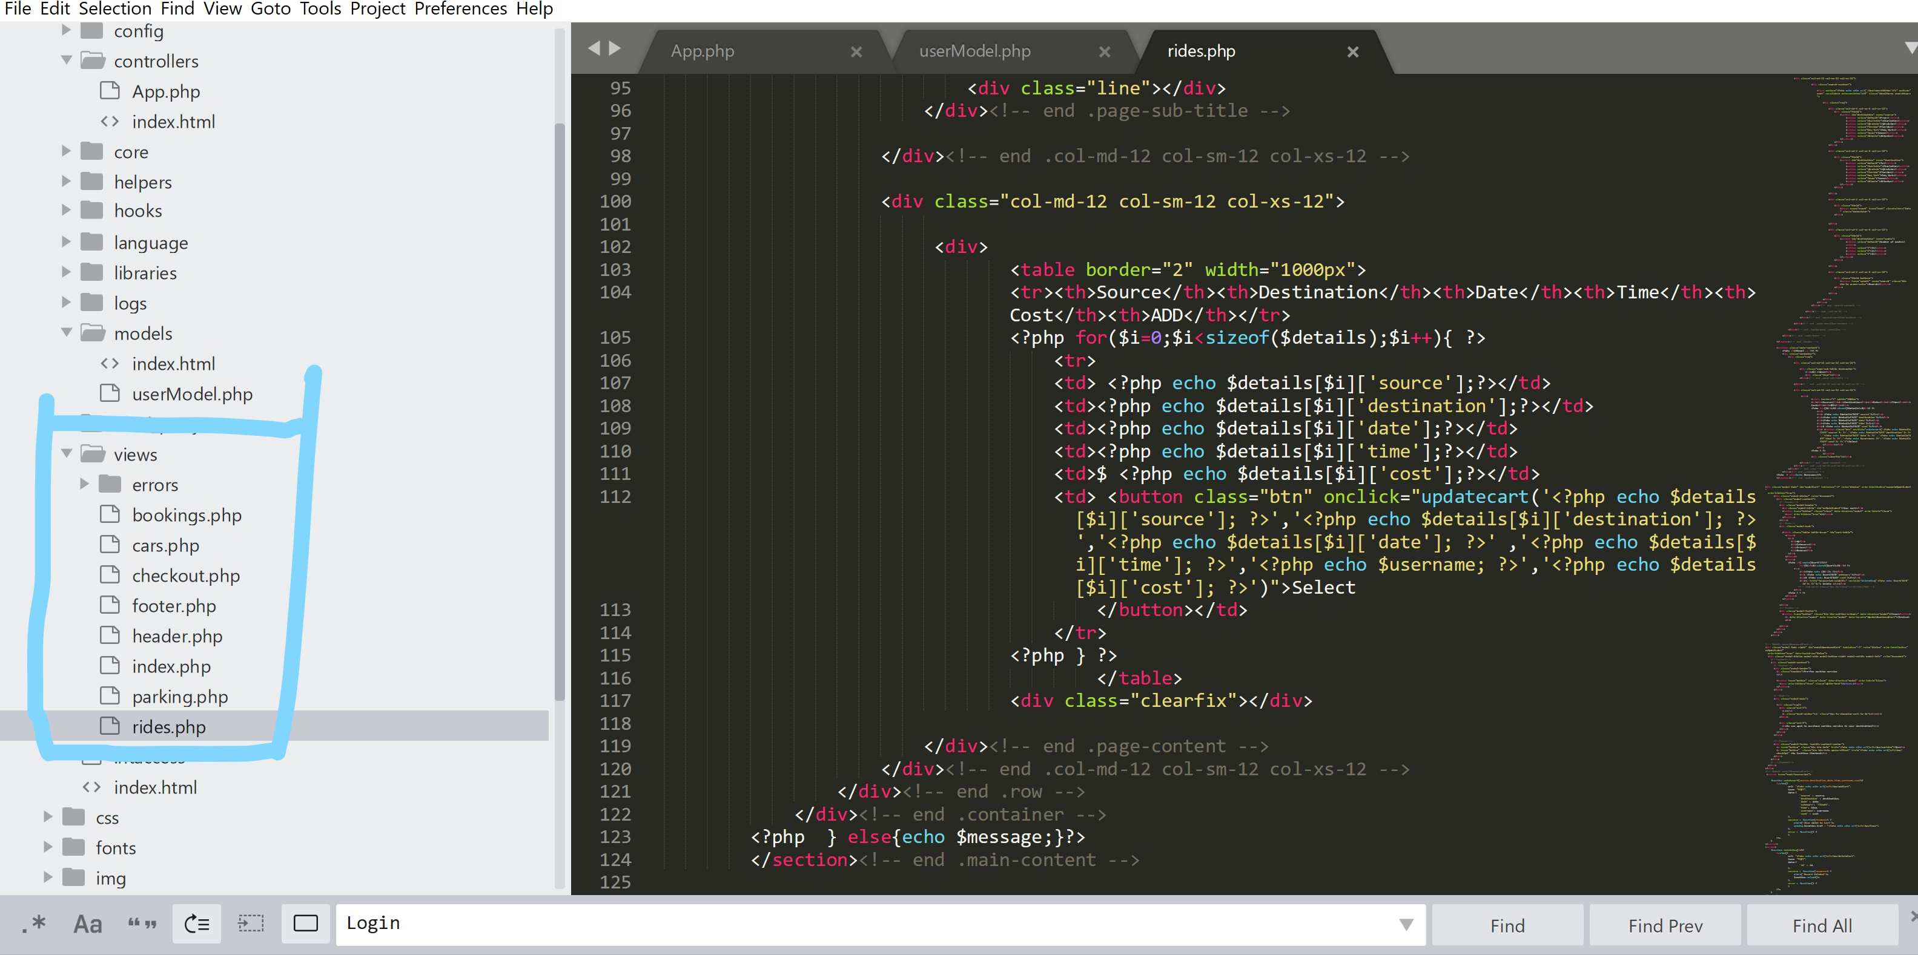
Code Snippets - Views (MVC)

Slide 7
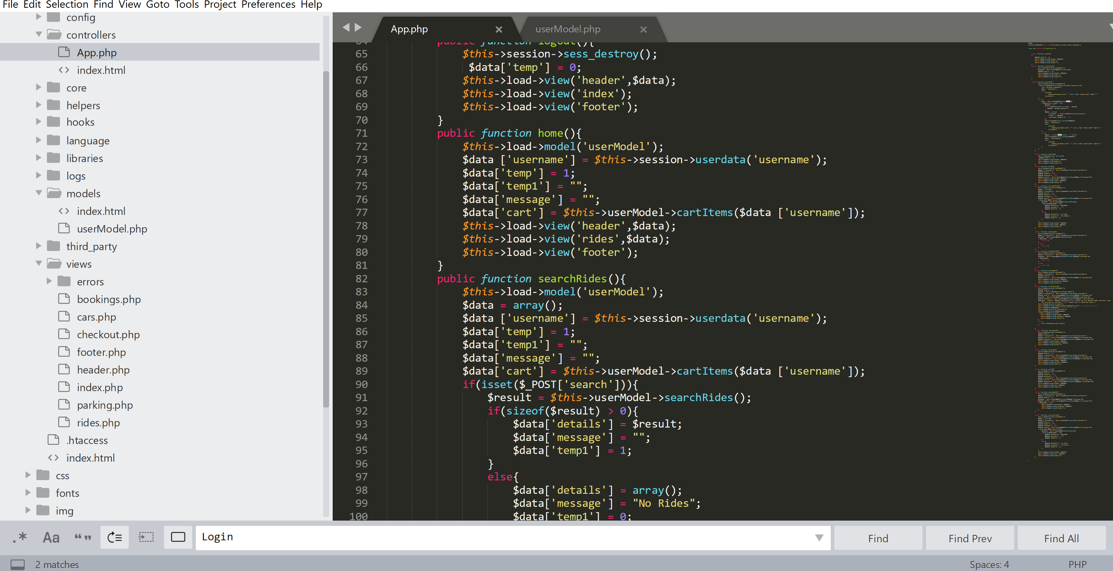
Code Snippets - Controller (MVC)

Slide 8
Testing
Testing was done manually. Lots of refreshing to adjust the looks of the pages. Also, adding mock data in our database and in our website to try out the different use cases, to see if everything is functional.

Slide 9
Questions?
If you have any questions, feel free to comment below.

